Slide 1
Oil Price Downturns: Some Bankruptcy Thoughts PLANO Executive Night Seminar April 16, 2015
Presented by
Louis M. Phillips
Rick M. Shelby
Attorneys, Gordon Arata Law Firm
New Orleans, Louisiana

Slide 2
TOPICS 1. Oil Price – Recent Trends and Consequences 2. Reorganization 3. Bankruptcy Key Concepts 4. Recent Case Study – ATP
Open Panel Discussion

Slide 3
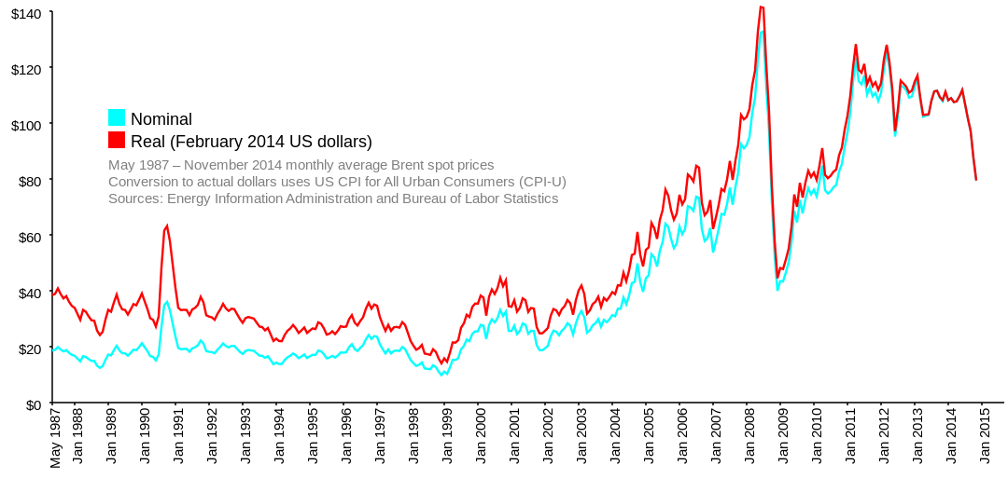

Slide 4
Recent Oil Price Implications
Following the 2008 recession, strong oil prices and the natural gas boom attracted increasing amounts of capital into the E&P industry.
The high oil prices led to increased revenues and asset values for the E&P industry supporting higher loan-to-value ratios.
Reserve-based revolving credit facilities and second lien debt became more accessible for industry participants to pursue E&P opportunities and smaller industry entrants could take advantage of “sunset” properties that were otherwise unattractive to larger E&P companies.
In addition, E&P companies became creative with royalty/production payment incentives offered to the capital market.

Slide 5
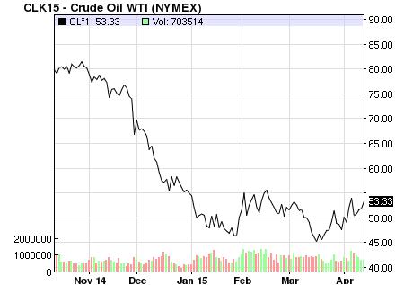

Slide 6
Recent Oil Price Implications
The recent collapse in oil price has resulted in big cash problems for highly leveraged companies.
Asset values decline and without sufficient revenue to fund operations and service debt, these companies are at the risk of default.
Scheduled (or unscheduled) borrowing base redeterminations likely reveal deficiencies that must be corrected.
Furthermore, despite the decrease in oil prices, current operational costs have not declined largely due to increased scrutiny of the industry post-Deepwater Horizon.

Slide 7
Additional Financial Pressures
Recently, the oil and gas industry has also been forced to address unfunded decommissioning obligations and related changes in regulations.
Deepwater Horizon increased insurance and financial assurance requirements; created the need for increased emphasis on safety and SEMs program; resulted in a corresponding drilling moratorium temporarily halting development opportunities
The extreme of how bad the problem can get was recently demonstrated in the ATP bankruptcy caused largely by a combination of many of these concepts
Royalty assignments and funding operations with debt
P&A funding and related bonding requirements
Drilling Moratorium – suit against United States
Creation of Risk Management Program – Recent NTLs re: bonding

Slide 8
Potential Options
Lean and Mean – lower leveraged companies with stable balance sheets will see decreased revenues and focus on their spending flexibility; these companies will be best positioned for future growth when assets are shed at lower oil prices and oil prices rebound; executives should focus on projections
Loan Workouts – higher leveraged companies who are in default may seek forbearance agreements and implement cost-cutting strategies including dumping assets
Reorganization – bankruptcy may offer the ability to restructure debt consistent with the assets’ current value and at potentially lower interest rates; additional benefits include rejecting unfavorable agreements, discharging debt and maintaining current operations
Liquidation – as a last resort, liquidate assets to pay debt

Slide 9
Chapter 11 Reorganization Discussion
Chapter 11 Benefits
Provides the opportunity for a “fresh start”
Treatment and classification of claims
Automatic stay
Preservation of property for the benefit of secured creditors
Assumption and/or rejection of executory contracts
Abandonment of burdensome property
Continued operation of businesses
Chapter 11 Basic Requirements
Monthly Reporting
Filing of Schedules and Statements
Employment of Professionals
Bankruptcy Approval of Settlements

Slide 10
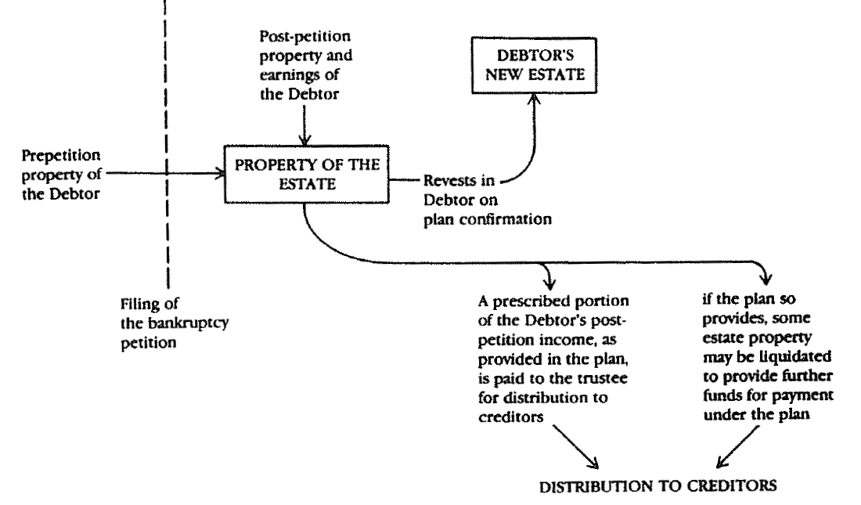
Key Concept: Property of the Estate
11 U.S.C. § 541 – an estate is created by commencement of the bankruptcy case
All legal or equitable interests of the debtor in property as of the commencement of the case
NOTE: Section 541 does not define the interests. The question of whether or not the debtor has an interest in property and the determination of the nature and extent of interest is resolved under nonbankruptcy law.
Notes:
The filing of a bankruptcy petition instantaneously creates an estate composed of all the debtor’s legal and equitable property interests. See 11 U.S.C. § 541. The Supreme Court has held that bankruptcy does not define property rights; rather, property rights are created and defined by applicable non-bankruptcy law. Butner v. U.S., 440 U.S. 48, 54-55 (1979); Patterson v. Shumate, 504 U.S. 753, 758 (1992). If, under applicable non-bankruptcy law, the debtor does not have a legal or equitable interest in the property as of the commencement of the case, the property does not become property of the bankruptcy estate.

Slide 11
Classification of Claims
11 USC § 1122
Secured – evidence of an interest in collateral
LOWLA and 11 USC 546(b) and perfection of security interest
RS 9:4863(A) – property subject to LOWLA privilege
RS 9:4865 – recordation/enforcement/lis pendens deadlines
Endeavor Operating Corp. – creditors argue lack of perfection
Unsecured
Administrative
Priority
General Unsecured
Equity Interests
New Value Exception

Slide 12
Bankruptcy Principles to Shed Liabilities
Abandonment of Burdensome Assets
11 U.S.C. § 554
Administrative burden – no value/no benefit
Midlantic Nat’l Bank v. New Jersey Dept. of Environmental Protection, 474 U.S. 494 (1986) = a debtor cannot abandon property that would violate decommissioning regulations “reasonably designed to protect the public health or safety from identified hazards.”

Slide 13
ATP Bankruptcy Case Background
Case No. 12-36187 (Isgur) – S.D. Texas
ATP sought Chapter 11 bankruptcy protection in August 2012, citing dramatically reduced cash flows from the deepwater drilling moratorium.
Much of ATP’s development and production was funded by debt.
ATP was exempt from supplemental bonding until July 31, 2012 when DOI revoked ATP’s exempt status.
ATP filed for bankruptcy in August 2012, leaving its assessed decommissioning liabilities un-bonded

Slide 14
ATP Moved to Shed Residual Decommissioning Liabilities pursuant to Section 554
The ATP court permitted abandonment in light of Midlantic
In re ATP Oil & Gas Corp., 2013 WL 3157567, (Bankr. S.D. Tex. June 19, 2013) = Midlantic did not hold that a debtor may abandon property where abandonment would be consistent with – and perhaps in furtherance of – an environmental regulatory scheme.
Notes:
The DOI and Anadarko objected to abandonment
DOI – ATP cannot abandon environmental liabilities under Midlantic
Anadarko – same; as only P-I-T, Anadarko would be saddled with decommissioning liability
DOI withdrew objection, preserving admin claim
Judge Isgur permitted abandonment under Midlantic
Under the applicable decommissioning regulations, DOI could look to Anadarko to satisfy decommissioning obligations (at least for wells and facilities in place when Anadarko transferred its interest to ATP and for which ATP had no security posted).

Slide 15
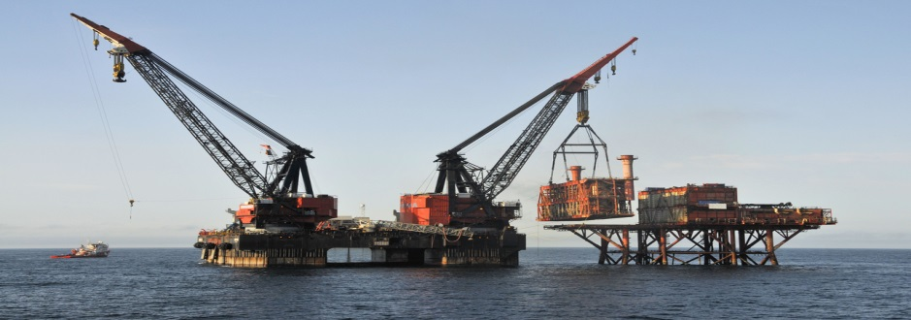
Regulatory decommissioning liabilities
§ 250.1701 Who must meet the decommissioning obligations in this subpart?
(a) Lessees and owners of operating rights are jointly and severally responsible for meeting decommissioning obligations for facilities on leases, including the obligations related to lease-term pipelines, as the obligations accrue and until each obligation is met.
§ 250.1702 When do I accrue decommissioning obligations?
You accrue decommissioning obligations when you do any of the following:
(a) Drill a well;
(b) Install a platform, pipeline, or other facility;
(c) Create an obstruction to other users of the OCS;
(d) Are or become a lessee or the owner of operating rights of a lease on which there is a well that has not been permanently plugged according to this subpart, a platform, a lease term pipeline, or other facility, or an obstruction;
(e) Are or become the holder of a pipeline right-of-way on which there is a pipeline, platform, or other facility, or an obstruction; or
(f) Re-enter a well that was previously plugged according to this subpart.

Slide 16
Residual liability under 30 CFR 556.62:
You do not gain a release from any accrued obligation under your lease or the regulations by assigning your record title interest or transferring your operating rights in the lease.
You are jointly and severally liable for the performance of each nonmonetary obligation under the lease and under the with each prior lessee and with each operating rights owner holding an interest at the time the obligation accrued, unless this chapter provides otherwise.
Sublessees and operating rights owners are jointly and severally liable for the performance of each nonmonetary obligation under the lease and under the regulations in this chapter to the extent that:
The obligation relates to the area embraced by the sublease; and
Those owners held their respective interest at the time the obligation accrued

Slide 17
IN RE: ATP OIL & GAS CORPORATION, Debtor(s). Motion to Abandon Gomez Properties
The Court is not unsympathetic to Anadarko. It may be forced to bear a substantial cost as a result of ATP’s financial woes. Nevertheless, like many things in a bankruptcy case, the cost that Anadarko may bear is a reflection of the credit risk it took. Anadarko sold a portion of the Gomez Properties to ATP, and required ATP to bear the financial burden of plugging and abandonment in accordance with applicable federal law. This unfortunate position is no different from that of any other creditor that relies on the promise of performance from an eventually failed entity. In re ATP Oil & Gas Corp., 2013 WL 3157567, (Bankr. S.D. Tex. June 19, 2013)

Slide 18
Anadarko’s Relief?
DOI, ATP and Anadarko ultimately settled with Anadarko receiving proceeds of ATP’s $3 million area wide bond but responsible for decommissioning properties
The Anadarko decommissioning settlement agreement also preserved any administrative expense claim arising out of the maintenance and decommissioning of the platform and MC 711 Lease.
Anadarko filed a proof of claim on 1/6/2014 for $115,217,808 of projected maintenance and decommissioning costs.

Slide 19
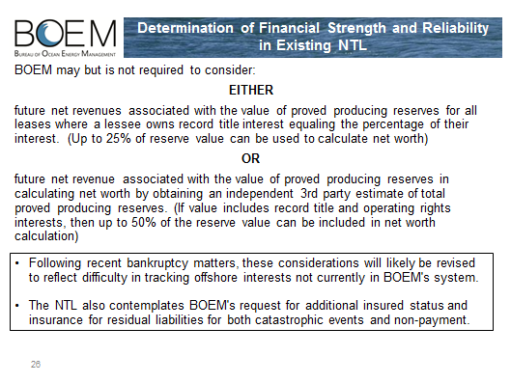
Donna Dixon – 2014 OCS Workshop
Notes:
Donna Dixon is currently the Program Manager for BOEM's new Office of Risk Management which has been developed as a national offshore risk management effort under the leadership of Tommy Beaudreau, Walter Cruickshank and John Rodi. This program is expected to operate at BOEM's HQ and in all of the Bureau's Regions.

Slide 20
Executory Contracts
Countryman definition
Continued performance of contracts & cure reqs.
11 USC 365(d)(4) – unexpired leases of nonresidential real property
ATP moves to reject OCS leases and classify carved out interests (ORR) as property of the estate
DOI supports ATP’s position agreeing that OCS leases are merely contractual leasehold rights

Slide 21
Bankruptcy Safe Harbors
Section 541(d) – equitable title
Section 541(b)(4) – farmouts
Section 541(b)(4)(B) – production payments
production payment – a “term overriding royalty satisfiable in cash or in kind—(A) contingent on the production of a liquid or gaseous hydrocarbon from particular real property; and (B) from a specified volume, or a specified value, from the liquid or gaseous hydrocarbon produced from such property, and determined without regard to production costs.” 11 U.S.C. § 101(42A).

Slide 22
Joint Operating Agreements
Executory Contracts – severability of provisions
Recordation of JOA for perfection of lien provisions
Prior to assumption/rejection
JOA only enforceable by debtor not against the debtor
Ipso Facto Clauses – automatic stay
Enforcement of obligations or termination
No automatic right to offset
JOA may call for interim committee to operate
Issue – non-consent by a debtor party to the JOA and then subsequent rejection of the JOA

Slide 23
Mineral Interest Owners
Prepetition royalty claim – unsecured claim
Exceptions: lease language, other agreements, statutory entitlements
Lease termination rights
Automatic stay
State law rights – statutory liens
Interim bankruptcy court approval to pay prepetition royalties to prevent harm to the estate

Slide 24
Chapter 11 Confirmation
Disclosure Statement – Section 1125
Adequate information
Approval of Plan of Reorganization – Section 1129
Impairment of Claims
Fair and Equitable test – secured creditors receive value of collateral
Absolute priority rule – treatment of equity interests

Slide 25
Questions and Comments

