Slide 1
API Delta Section Joint Society Luncheon
11/13/2018
Mike Celata | Director, Gulf of Mexico Region

Slide 2
Outer Continental Shelf Lands Act
“(T)he outer Continental Shelf is a vital national resource reserve held by the Federal Government for the public, which should be made available for expeditious and orderly development, subject to environmental safeguards, in a manner which is consistent with the maintenance of competition and other national needs”
Outer Continental Shelf Lands Act
Sec 3(3)

Slide 3
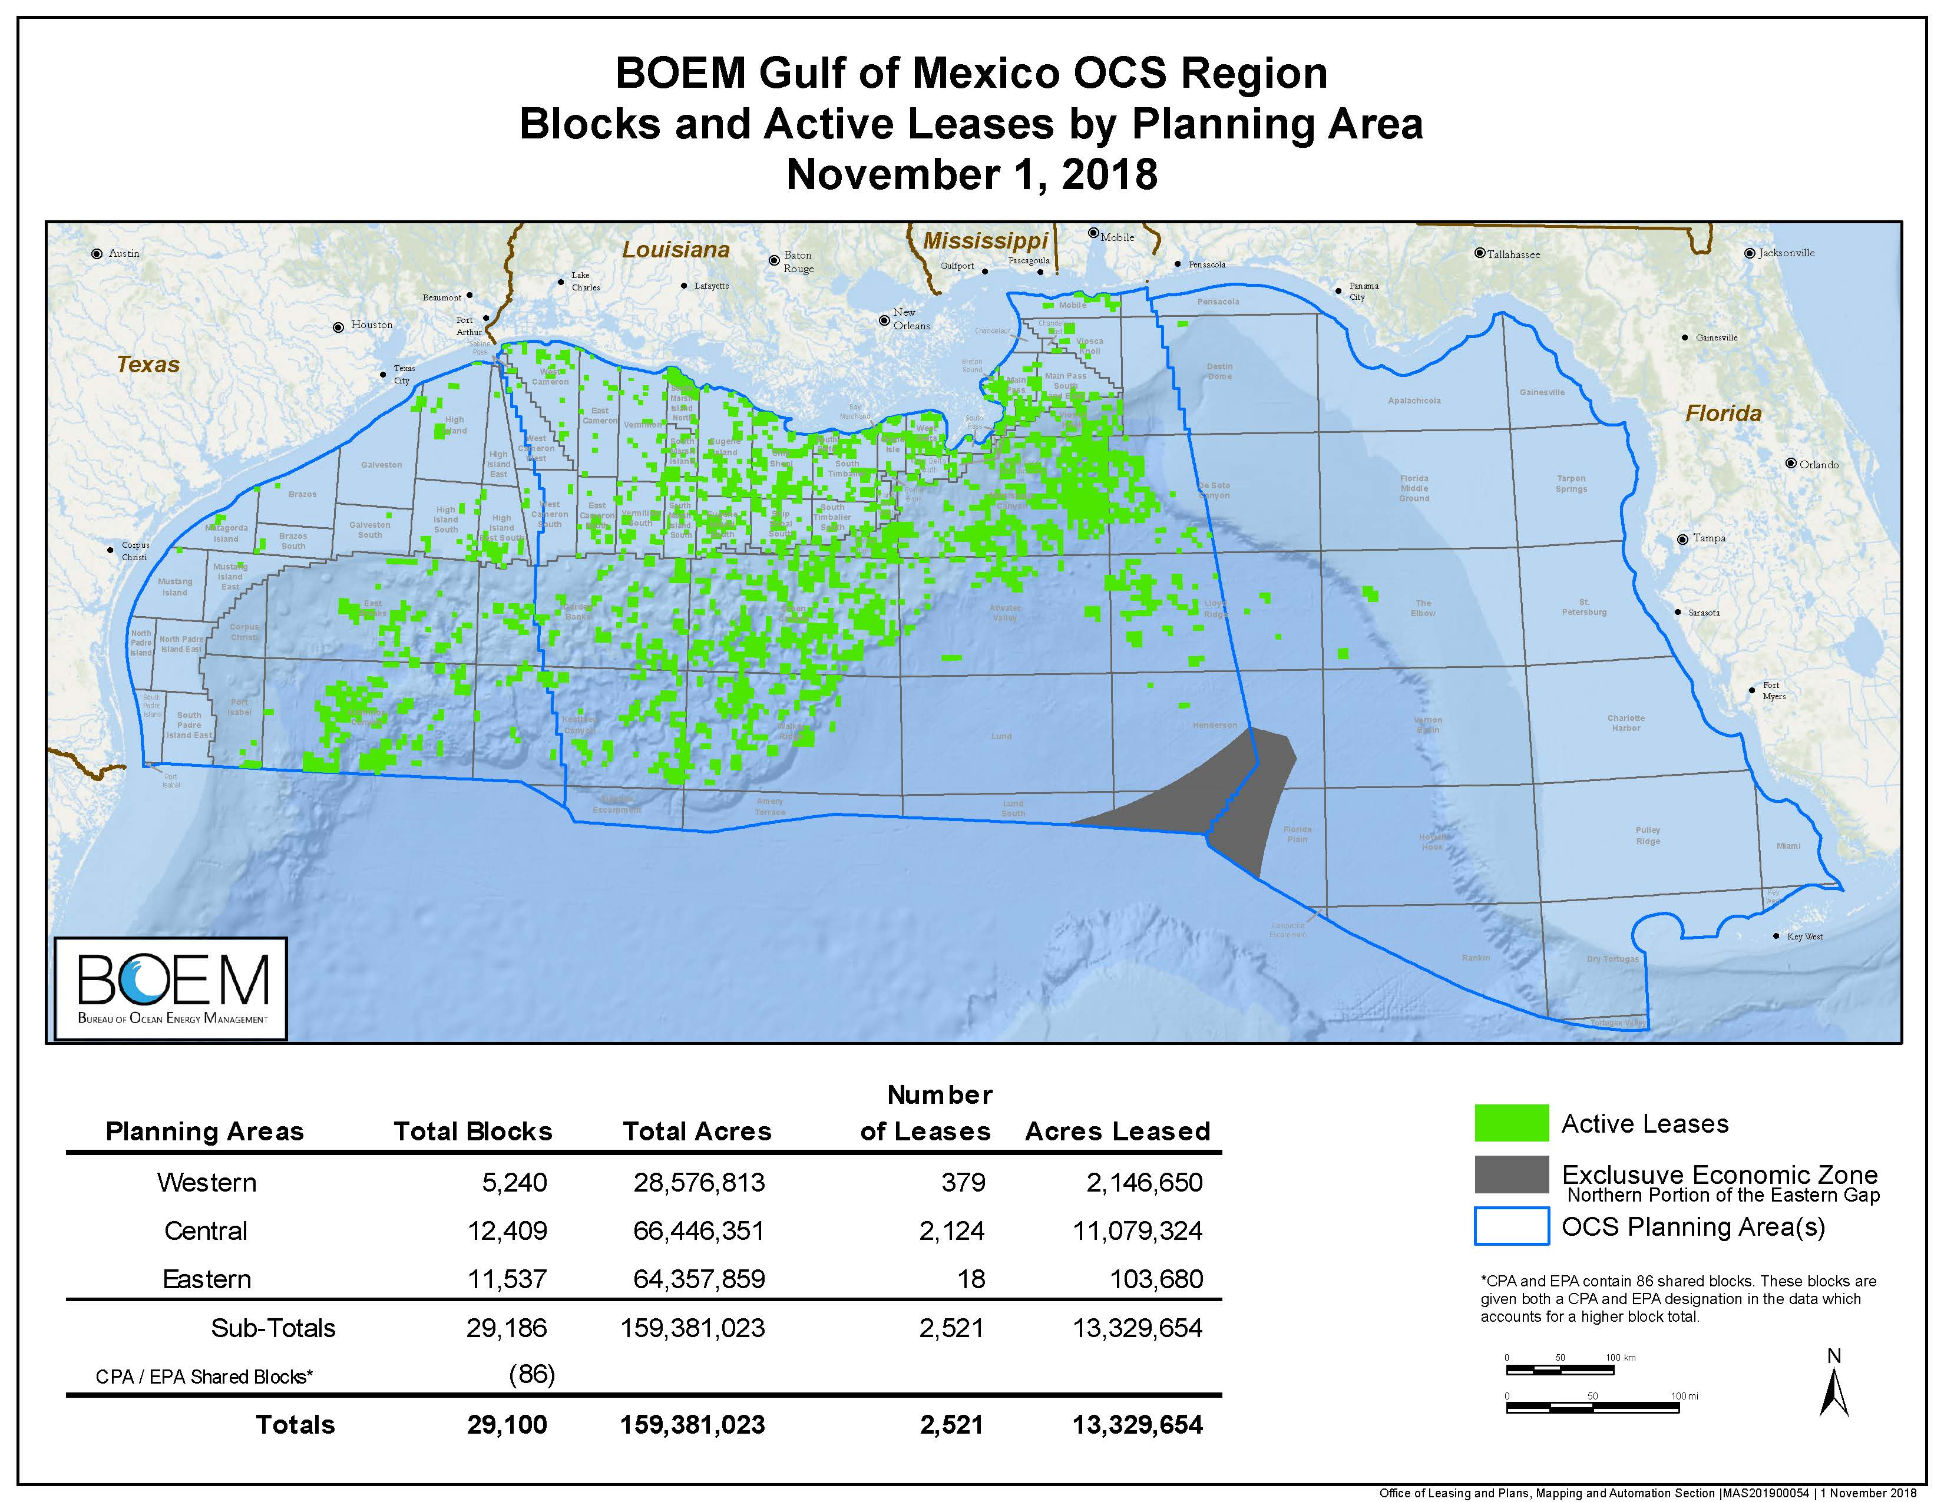
U.S. Gulf of Mexico Leasing Activity

Slide 4
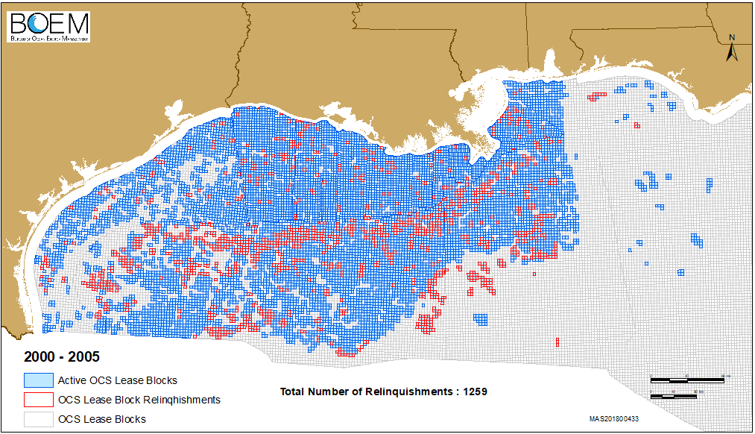
U.S. Gulf of Mexico Lease Activity

Slide 5
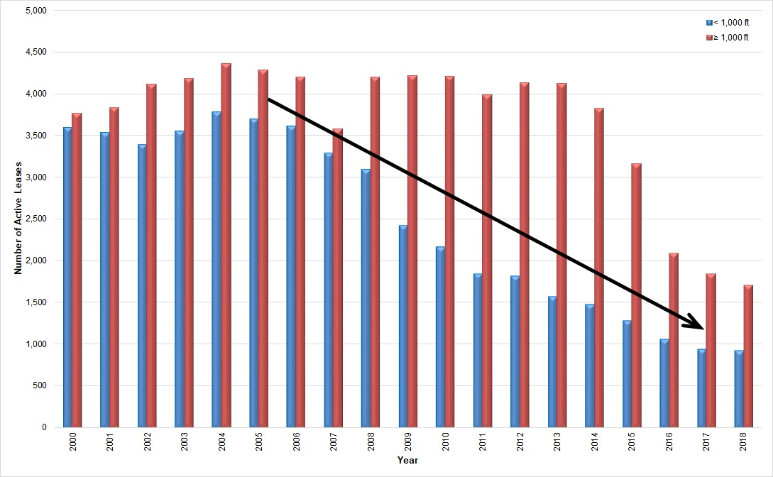
Leasing Trend

Slide 6
Gulf of Mexico Highlights
Lease Sale |  | Date of Sale | No. of Tracts Offered | No. of Tracts Bid On | No. Of Bids Received | Total Bonus High Bid ($)
251 | Gulf-wide | 8/15/18 | 14622 | 144 | 171 | 178.1M
250 | Gulf-wide | 3/21/2018 | 14474 | 148 | 159 | 124.8M
249 | Gulf-wide | 8/16/2017 | 14220 | 90 | 99 | 121.1 M
247 | CGOM | 3/22/2017 | 9118 | 163 | 189 | 274.8 M
248 | WGOM | 8/24/2016 | 4399 | 24 | 24 | 18.1 M
226 | EGOM | 3/23/2016 | 162 | 0 | 0 | 0
241 | CGOM | 3/23/2016 | 8349 | 128 | 148 | 156.4 M
246 | WGOM | 8/19/2015 | 4083 | 33 | 33 | 22.7 M
235 | CGOM | 3/18/2015 | 7788 | 169 | 195 | 538.8 M
238 | WGOM | 8/20/2014 | 4026 | 81 | 93 | 110 M
225 | EGOM | 3/19/2014 | 134 | 0 | 0 | 0
231 | CGOM | 3/19/2014 | 7511 | 326 | 380 | 850.8 M
233 | WGOM | 8/28/2013 | 4036 | 56 | 64 | 123.7 M

Slide 7
Monthly Oil Production from U.S. Gulf of Mexico
Source: U.S. Energy Information Administration, https://www.eia.gov/outlooks/steo/

Slide 8
BOEM Production Forecast

Slide 9
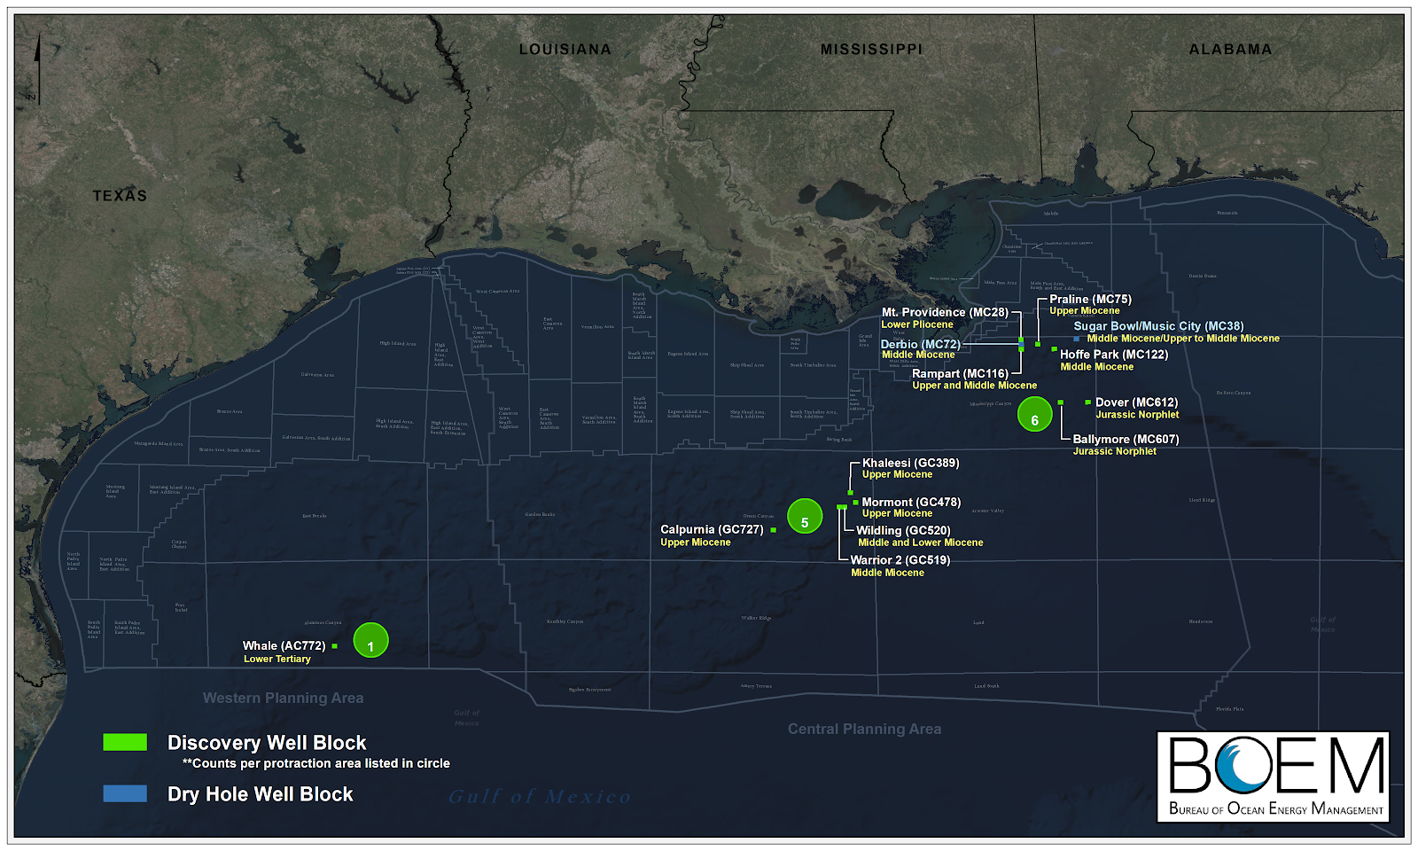
Discoveries

Slide 10
Shallow vs. Deep

Slide 11
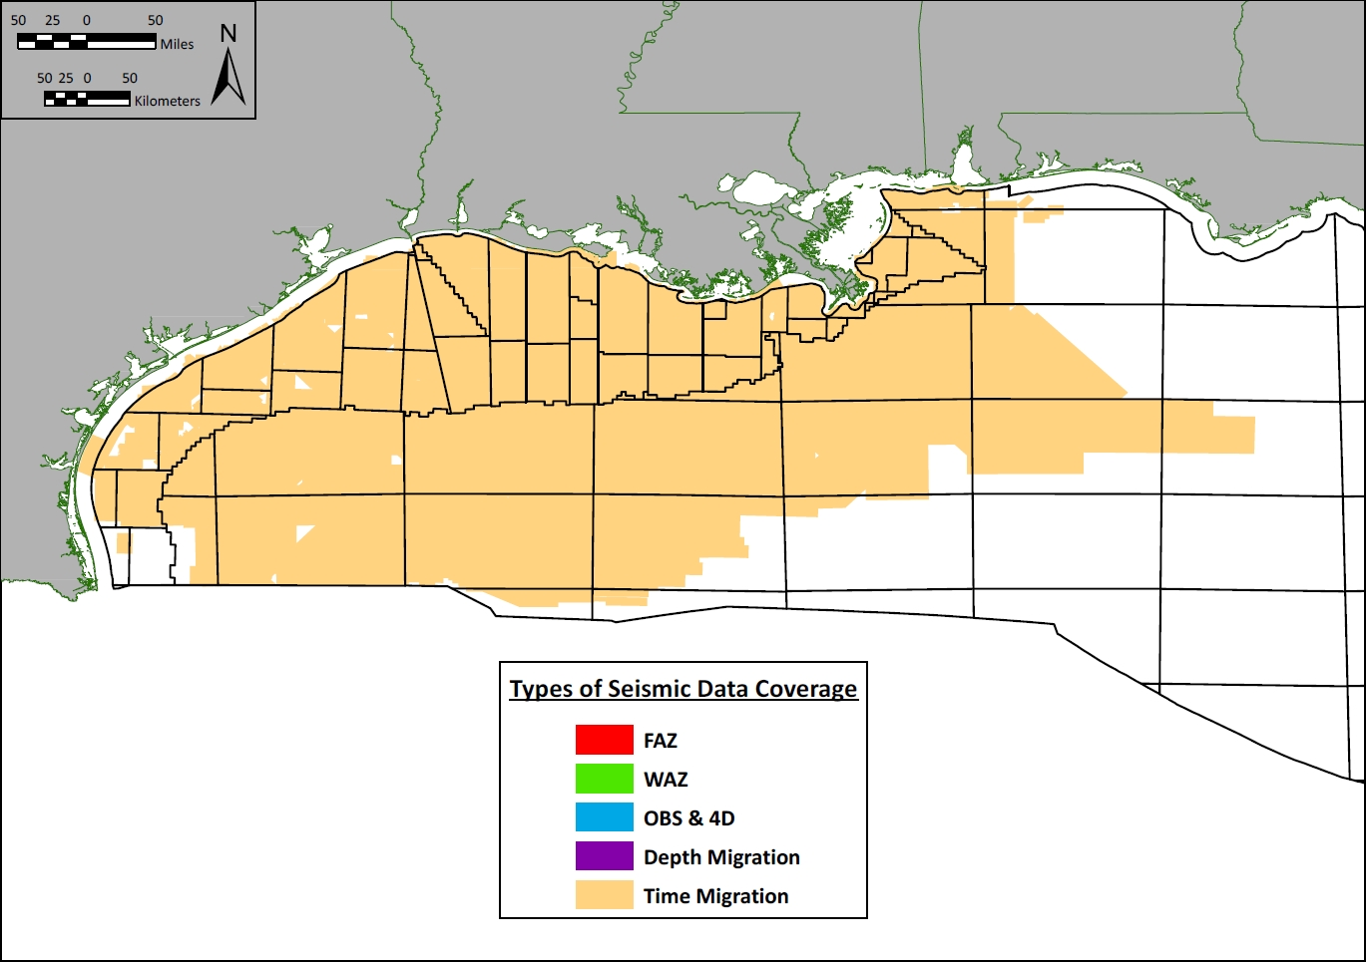
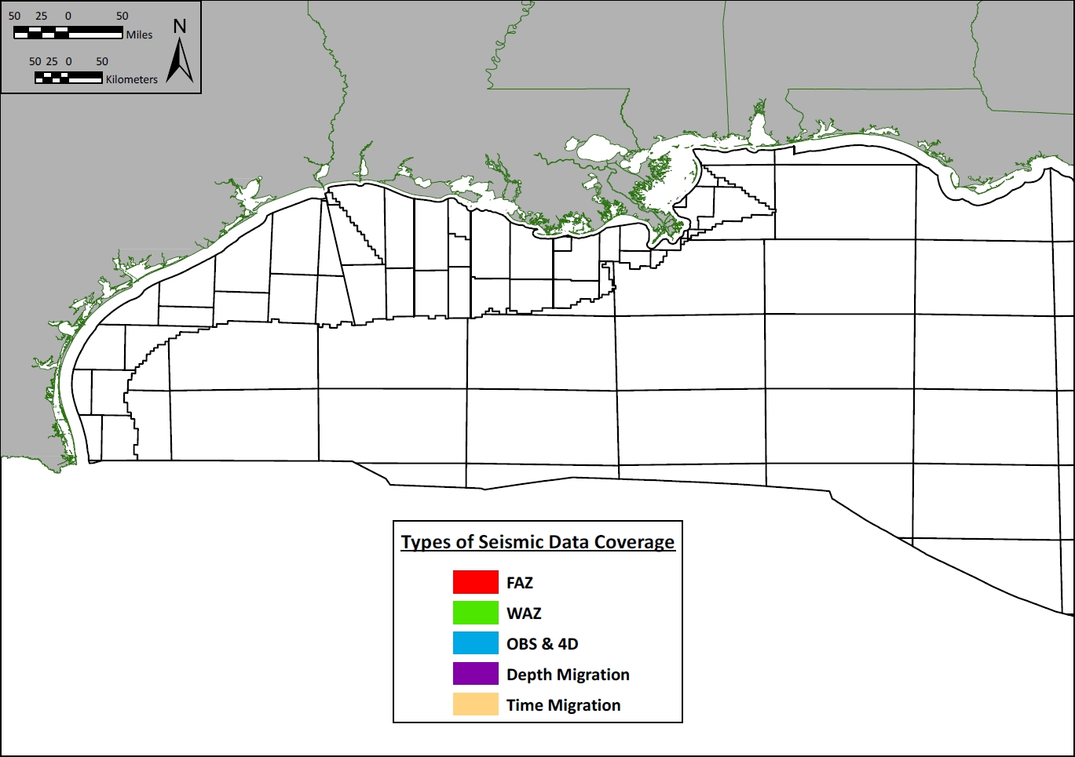
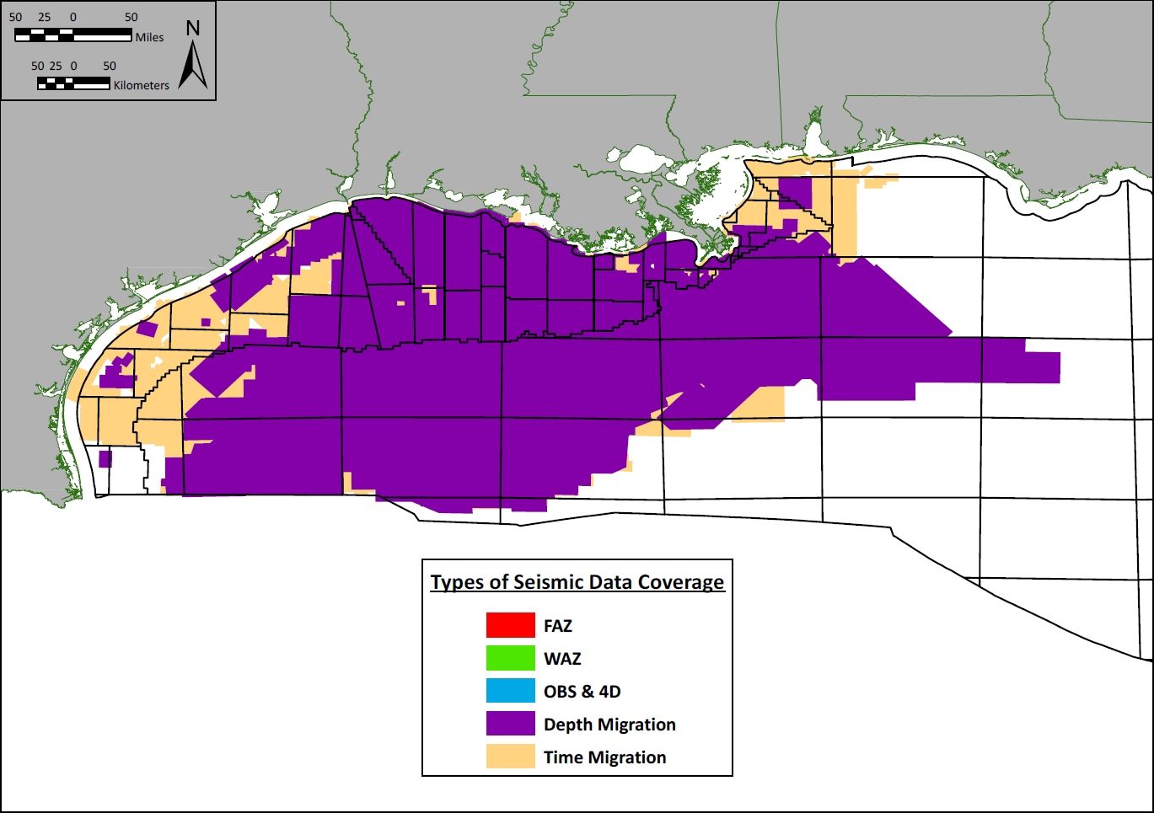
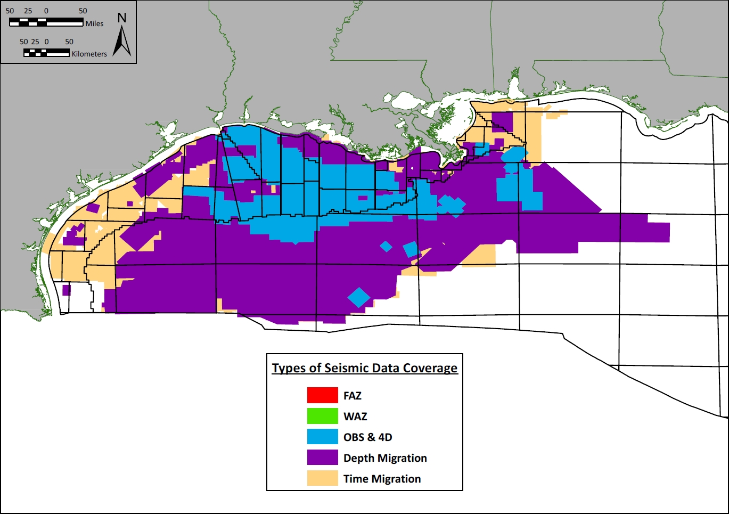
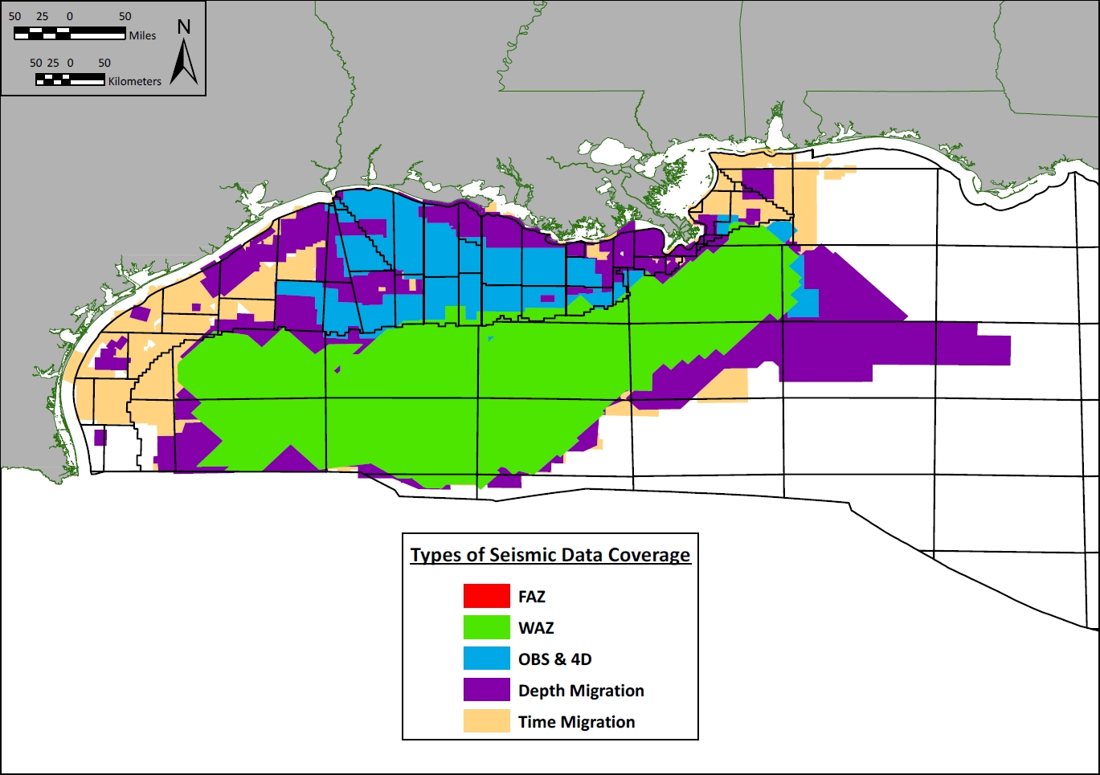
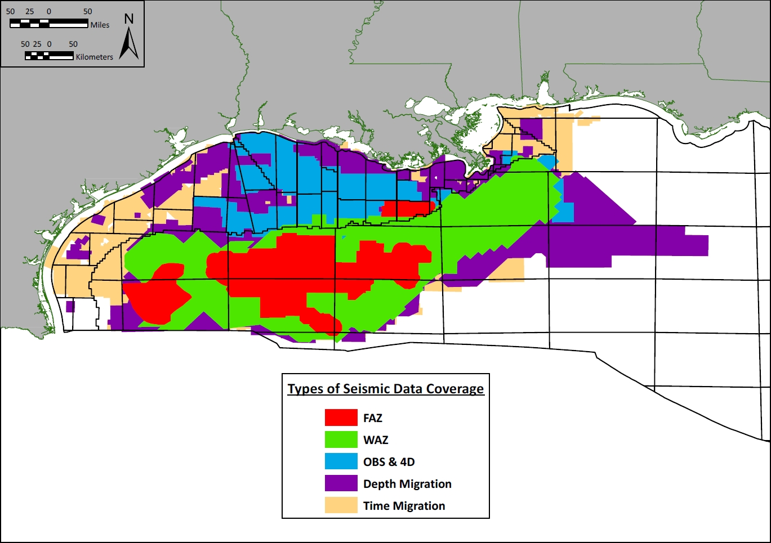
Seismic Data
Notes:
{Click to add the other layers one at a time, with WAZ and FAZ on top. This coverage is what the government has selectively obtained copies of, which is probably most acquired surveys, but maybe not a few.}
The need for better subsalt imaging under the salt canopy spurred by the Lower Tertiary trend has led to recent technological advances allowing large, nonexclusive Wide-Azimuth (WAZ) and Full-Azimuth (FAZ) seismic surveys to be acquired and sold to industry for exploration in this important deepwater trend. Commercial WAZ and FAZ surveys now cover most of the salt canopy.
2-D Seismic since 60s
2006 The first commercial, wide-azimuth seismic survey was acquired in deepwater

Slide 12
U.S. Gulf of Mexico Outlook
The number of active deep water leases remains robust, accounts for over 70% of all leases in the Gulf of Mexico.
The deep water portion is assessed to contain 80% of the remaining undiscovered resources.
Production at all time high; the Energy Information Administration expects a continued rise in 2019.

Slide 13
Mike Celata | michael.celata@boem.gov | 504-736-2592

