Slide 1
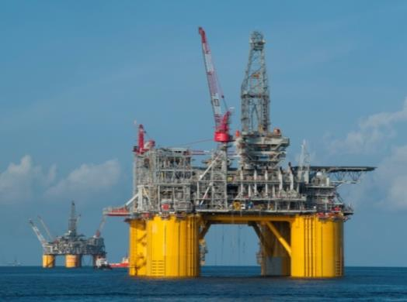
Key challenges To the future of deepwater GOM
Shell Upstream Americas (UA)
Deepwater
Use this area for cover image
(height 6.5cm, width 8cm)
John Hollowell
EVP UA Deepwater

Slide 2
CAUTIONARY NOTE
The companies in which Royal Dutch Shell plc directly and indirectly owns investments are separate entities. In this presentation “Shell”, “Shell group” and “Royal Dutch Shell” are sometimes used for convenience where references are made to Royal Dutch Shell plc and its subsidiaries in general. Likewise, the words “we”, “us” and “our” are also used to refer to subsidiaries in general or to those who work for them. These expressions are also used where no useful purpose is served by identifying the particular company or companies. ‘‘Subsidiaries’’, “Shell subsidiaries” and “Shell companies” as used in this presentation refer to companies over which Royal Dutch Shell plc either directly or indirectly has control. Companies over which Shell has joint control are generally referred to “joint ventures” and companies over which Shell has significant influence but neither control nor joint control are referred to as “associates”. In this presentation, joint ventures and associates may also be referred to as “equity-accounted investments”. The term “Shell interest” is used for convenience to indicate the direct and/or indirect (for example, through our 23% shareholding in Woodside Petroleum Ltd.) ownership interest held by Shell in a venture, partnership or company, after exclusion of all third-party interest. This presentation contains forward-looking statements concerning the financial condition, results of operations and businesses of Royal Dutch Shell. All statements other than statements of historical fact are, or may be deemed to be, forward-looking statements. Forward-looking statements are statements of future expectations that are based on management’s current expectations and assumptions and involve known and unknown risks and uncertainties that could cause actual results, performance or events to differ materially from those expressed or implied in these statements. Forward-looking statements include, among other things, statements concerning the potential exposure of Royal Dutch Shell to market risks and statements expressing management’s expectations, beliefs, estimates, forecasts, projections and assumptions. These forward-looking statements are identified by their use of terms and phrases such as ‘‘anticipate’’, ‘‘believe’’, ‘‘could’’, ‘‘estimate’’, ‘‘expect’’, ‘‘goals’’, ‘‘intend’’, ‘‘may’’, ‘‘objectives’’, ‘‘outlook’’, ‘‘plan’’, ‘‘probably’’, ‘‘project’’, ‘‘risks’’, “schedule”, ‘‘seek’’, ‘‘should’’, ‘‘target’’, ‘‘will’’ and similar terms and phrases. There are a number of factors that could affect the future operations of Royal Dutch Shell and could cause those results to differ materially from those expressed in the forward-looking statements included in this presentation, including (without limitation): (a) price fluctuations in crude oil and natural gas; (b) changes in demand for Shell’s products; (c) currency fluctuations; (d) drilling and production results; (e) reserves estimates; (f) loss of market share and industry competition; (g) environmental and physical risks; (h) risks associated with the identification of suitable potential acquisition properties and targets, and successful negotiation and completion of such transactions; (i) the risk of doing business in developing countries and countries subject to international sanctions; (j) legislative, fiscal and regulatory developments including regulatory measures addressing climate change; (k) economic and financial market conditions in various countries and regions; (l) political risks, including the risks of expropriation and renegotiation of the terms of contracts with governmental entities, delays or advancements in the approval of projects and delays in the reimbursement for shared costs; and (m) changes in trading conditions. All forward-looking statements contained in this presentation are expressly qualified in their entirety by the cautionary statements contained or referred to in this section. Readers should not place undue reliance on forward-looking statements. Additional risk factors that may affect future results are contained in Royal Dutch Shell’s 20-F for the year ended December 31, 2013 (available at www.shell.com/investor and www.sec.gov ). These risk factors also expressly qualify all forward looking statements contained in this presentation and should be considered by the reader. Each forward-looking statement speaks only as of the date of this presentation, 4/16/2015. Neither Royal Dutch Shell plc nor any of its subsidiaries undertake any obligation to publicly update or revise any forward-looking statement as a result of new information, future events or other information. In light of these risks, results could differ materially from those stated, implied or inferred from the forward-looking statements contained in this presentation. We may have used certain terms, such as resources, in this [report] that United States Securities and Exchange Commission (SEC) strictly prohibits us from including in our filings with the SEC. U.S. Investors are urged to consider closely the disclosure in our Form 20-F, File No 1-32575, available on the SEC website www.sec.gov. You can also obtain these forms from the SEC by calling 1-800-SEC-0330.

Slide 3
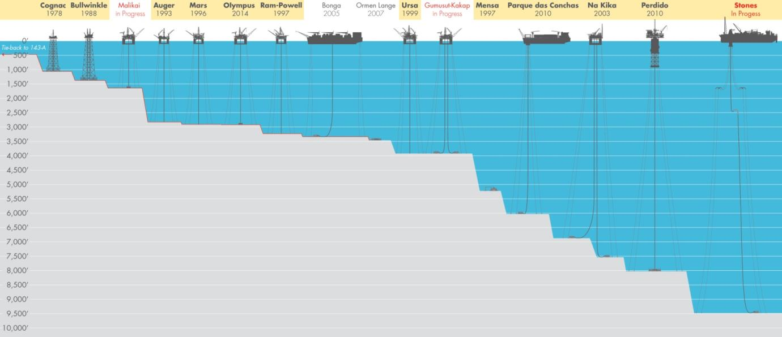
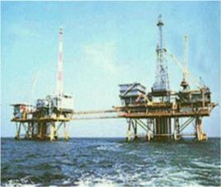
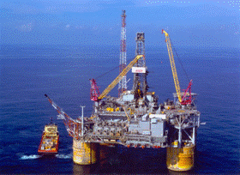
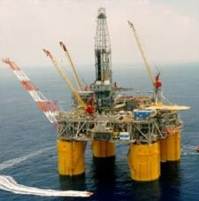
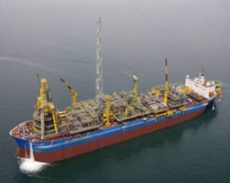
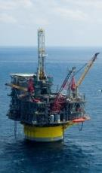
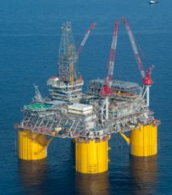
Shell deepwater: A history of pushing the limits
Cognac1978
Auger 1993
Mars 1996
Brazil – BC-10 2010
Perdido ‘10
Olympus 2013

Slide 4
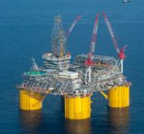
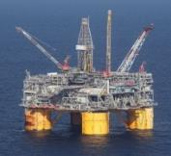
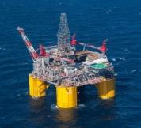
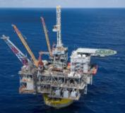
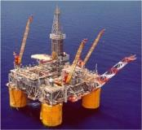
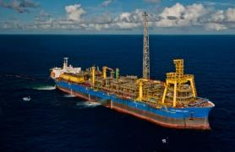
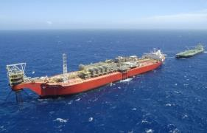
Ua Deepwater Portfolio
Auger TLP
Olympus TLP
Ursa TLP
1994
Brutus TLP
2014
1999
Mars TLP
Perdido Spar
2001
Ram Powell TLP
1996
2010
GOM
7 Floating Structures
3 Non-Operated Ventures
9 Active MODU Rigs
Brazil
2 FPSO’s
1 Active MODU Rig
Canada
Sable Non-Operated Venture
Production
~225 Wells (Prod/Inj)
TG Operated Prod. ~600 kboe/d
SN Prod. ~270 kboe/d
1997
Perdido Spar
Espirito Santo
BC-10 FPSO 2009
Fluminense
Bijupira-Salema FPSO 2003

Slide 5
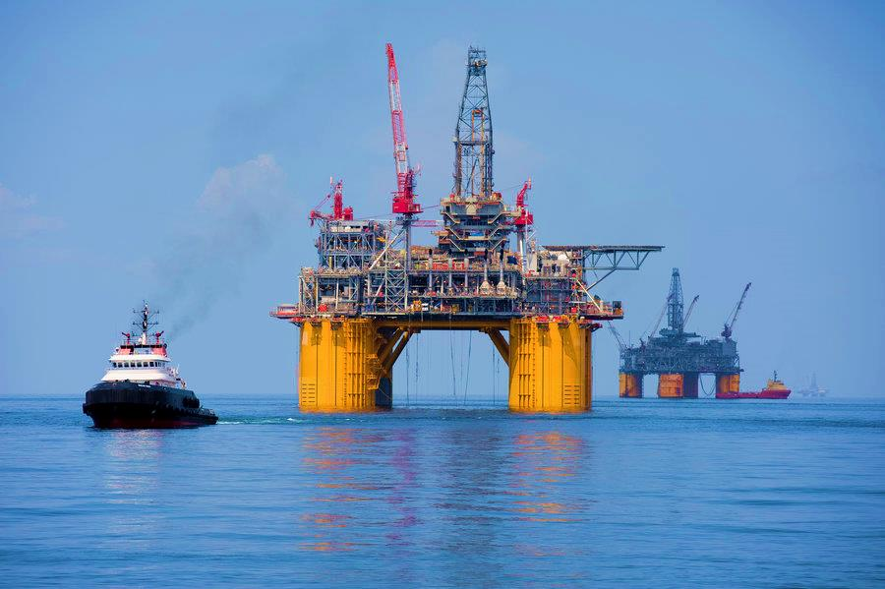
Olympus TLP: FOD Feb ‘14

Slide 6
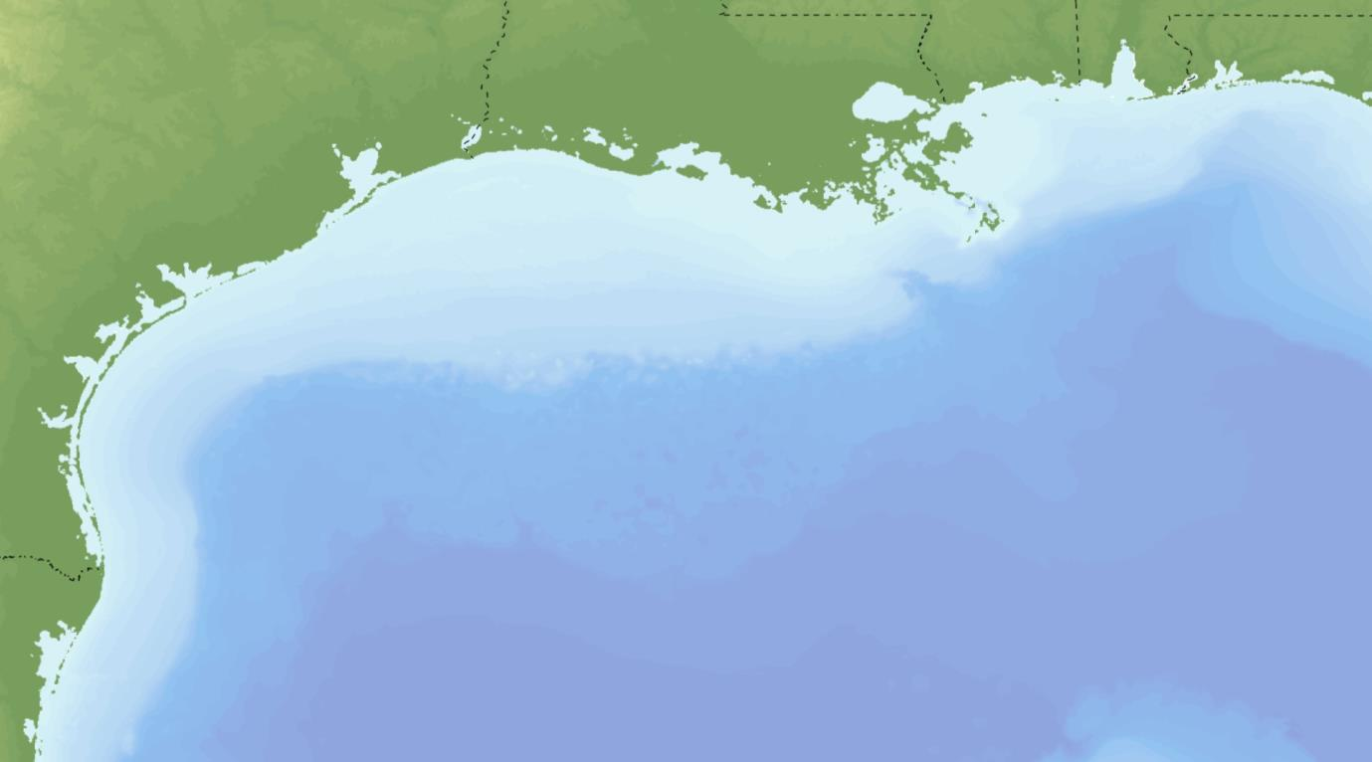
Current deepwater growth pipeline
WD 143
Nakika
Appomattox
Mars
Gettysburg W
Olympus
Kaikias
Rydberg
Ursa
Brutus
Vito
Power Nap
Auger
Caesar Tonga
Stones
Producing Asset
Perdido
Development Project
Discovery
Key Messages:
Exploration success (Cardamom, Appomattox, Vito, Vicksburg, Rydberg, Kaikias) spark new GoM DW growth opportunities.
Deepwater viewed as Growth Engine for Royal Dutch Shell

Slide 7
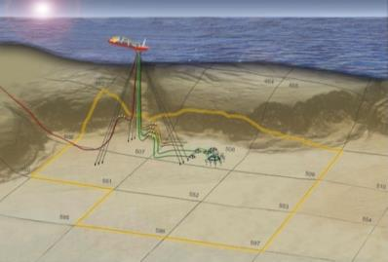
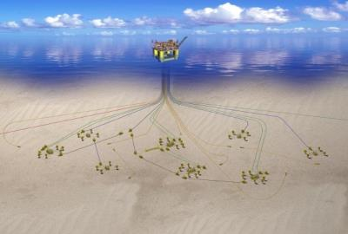
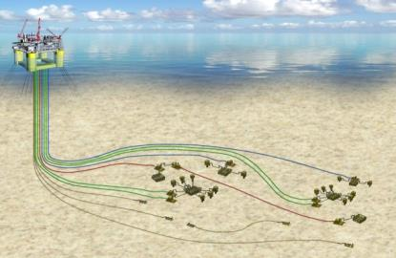
The Next frontier
  Stones
  Appomattox
  Vito
  Water Depth: ~9500 ft WD.
  Shell’s first GOM FPSO
  Shell’s 1st frontier Paleogene development
  Production potential: ~50kboe/d
  Water Depth: ~7200 ft.
  Jurassic Age Reservoirs
  Semi-Sub with Subsea tie-backs
  Production potential: ~150kboe/d
  Water Depth: ~4000 ft.
  Lower Miocene
  Semi-Sub with Subsea tie-backs.
  Production potential: ~100kboe/d
  CHALLENGES
  Ultra Deep Water
  Steep slope seabed
  High pressure
  Low perm, high viscosity
  Well cost
  CHALLENGES
  Technically Complex
  Deep reservoir
  Water Injection
  Well Cost
  CHALLENGES
  Deep Wells
  Technically Complex
  Low perm, high viscosity
  Artificial Lift
  HP Gas Injection
  Well Cost

Slide 8
Key challenges to the future of deepwater GOM
1
People capability
2
Capital intensity of Deepwater
3
Effective Partnerships
4
Subsea system reliability and intervention
5
Deepwater abandonment

Slide 9
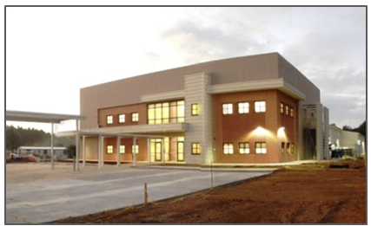


People capability: Expediting the learning curve!
Basic Offshore Operations Skills Training: BOOST
Structured 6-hitch (14 day hitch) learning program
Emulate the offshore work environment onshore (located at Robert Training Center)
  Wake up calls, morning meetings, JSAs, permits, BBSM ... All under the guidance of experienced offshore leadership
  Work on the “Robert TLP/Spar/FPSO”
Designed to deliver “ready-to-work operators in ~6
Provide OJT without POB!

Slide 10
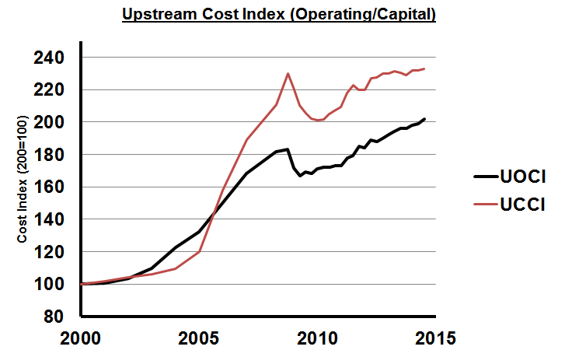
The Capital intensity of deepwater
  Complex fields create a more challenging business environment even with robust oil prices
  Deepwater Capex growth has outpaced production growth by as much as 250% in some areas
  Shareholder focus has gone beyond only being production focused
  Key cost drivers:
  Technical complexity & customization
  Product/Service cost and lead times
  Government driven cost
  Without step changes in cost, we are challenging the economics of Deepwater
Cost Index (2000=100)

Slide 11

Developing Effective partnerships
“Even if you're on the right track, you'll get run over if you just sit there.”
- Will Rogers
Like the other key aspects of our business our partnerships will need to evolve in order to maximize value from the GOM Deepwater business moving forward.
  Increased technical collaboration and commercial synergies
  Sustainable commercial structures delivering maximum value for venture partners
  Improved utilization of existing infrastructure through tie-backs & PHAs
  Deepwater GOM is a long term value proposition requiring stable/cooperative partner relationships

Slide 12
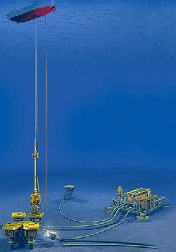
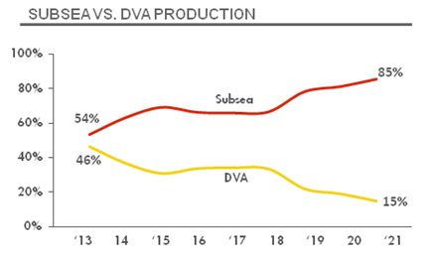
Subsea system reliability and intervention
  Current subsea system reliability is high (due to redundancy), but lower than DVA wells due to intervention lead time and ramp up durations
  As we grow our dependence on Subsea systems, redundancy and reliability of systems will be paramount
  Reducing intervention lead time and cost will be a key enabler for future subsea systems
  Developing resources and processes to prevent, predict and react to failures is critical in the next frontier of subsea

Slide 13
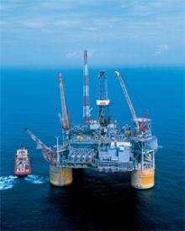
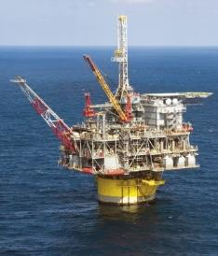
GOM Deepwater abandonment opportunity
Shell estimates the GOM industry subsea well/system abandonment liability to be ~$10 bln and growing.
Key Abandonment Needs:
  Industry collaboration (lumpy demand)
  Increased technical capability
  Step change in cost structure via technology enhancements
Cost
Floating Platforms
SS Systems
Fixed Platforms
DVA Wells
Maturity
The maturation of offshore abandonment.
Complex SS Fields
Conventional Shelf
TLP
SPAR

Slide 14
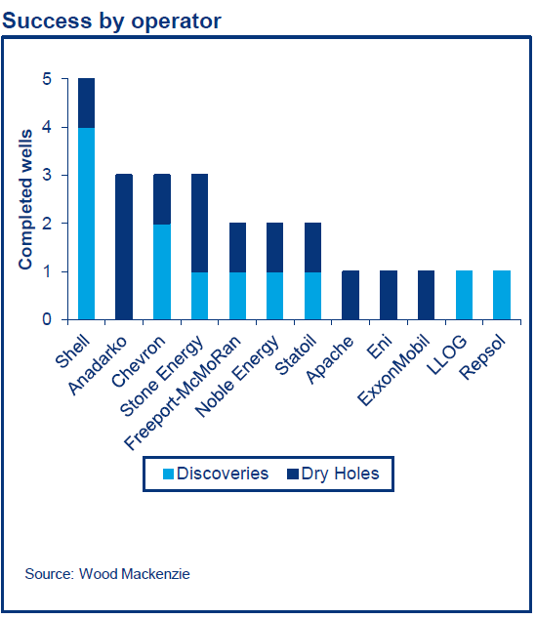
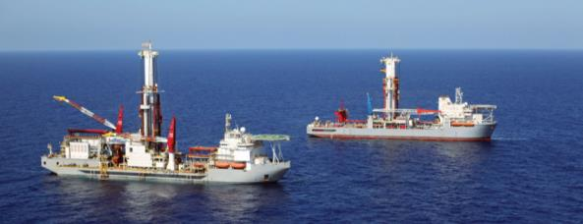
GOM DEEpwater: A Lot left to play for
  What’s left to play for?
  Est. 9 Bln boe GOM DW 1P/2P Reserves
  Est. 62 Bln boe GOM DW Undiscovered Reserves
  2014 Exploration Success
    12 Discoveries
    ~1.1 Bln boe discovered
  How do we win?
  Invest in people development
  Strengthen partnerships
  Continue to progress subsea system and intervention technology
  Improve abandonment collaboration

